Slide 1


Git and Github Code/slides: Joel Swift

Slide 2
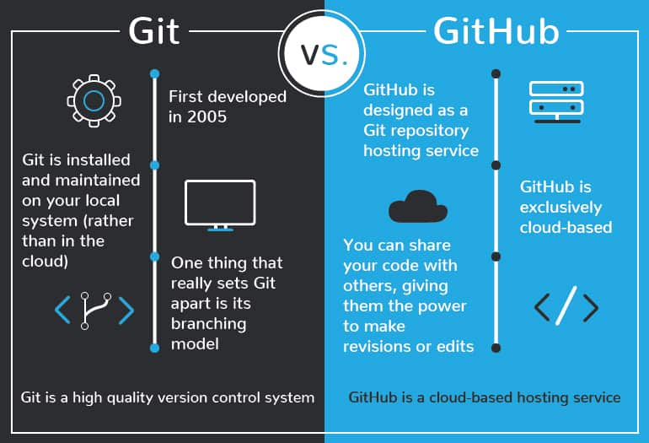
What the hell are git and github?
Git is a version control system.
Basically it allows for branched workflows, where multiple branches of a file or code can co-exist and be merged.
Github
A cloud based hosting service for hosting git projects (repositories, repos).
GUI support.
Was purchased by Microsoft for 7.5 billion in !
https://devmountain.com

Slide 3
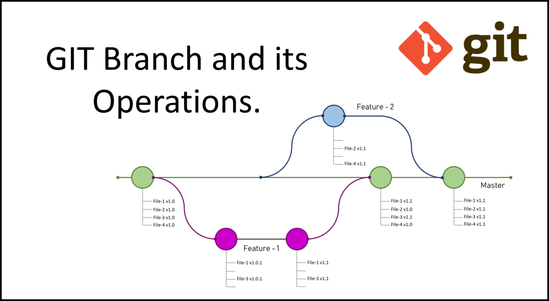
Branching model of Git

Slide 4
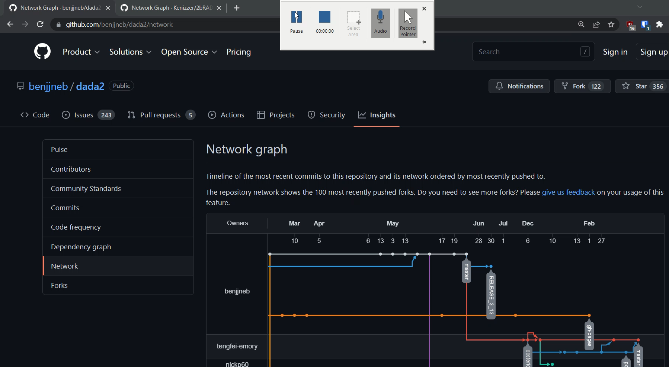
Real world examples (dada2 and my repo)

Slide 5
Github… make an account
Make an account
Setup 2FA (w/ mobile or hardware if you have it)

Slide 6

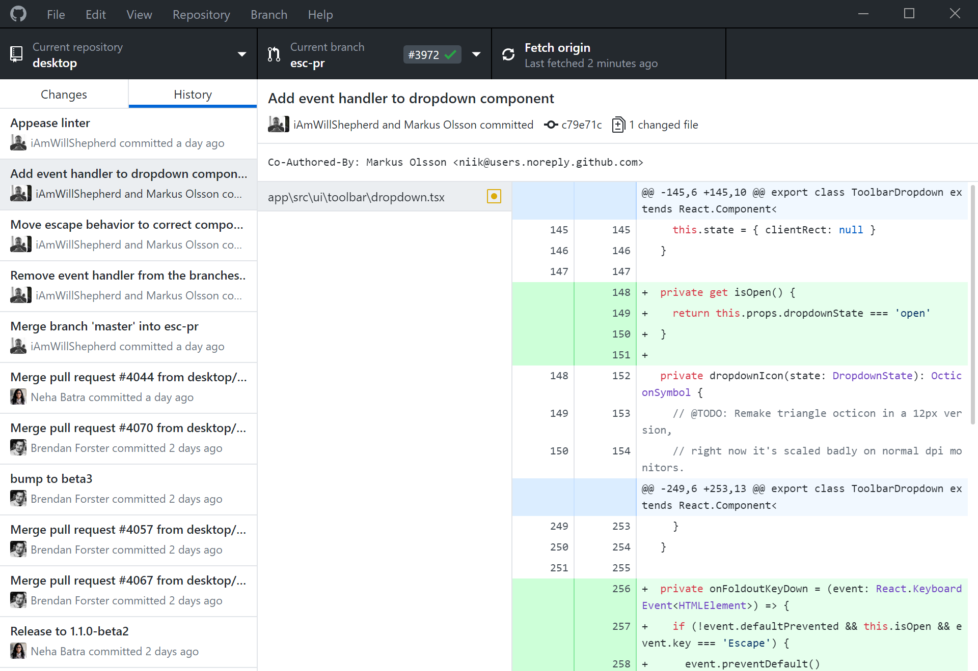
Github Desktop
https://desktop.github.com/

Slide 7
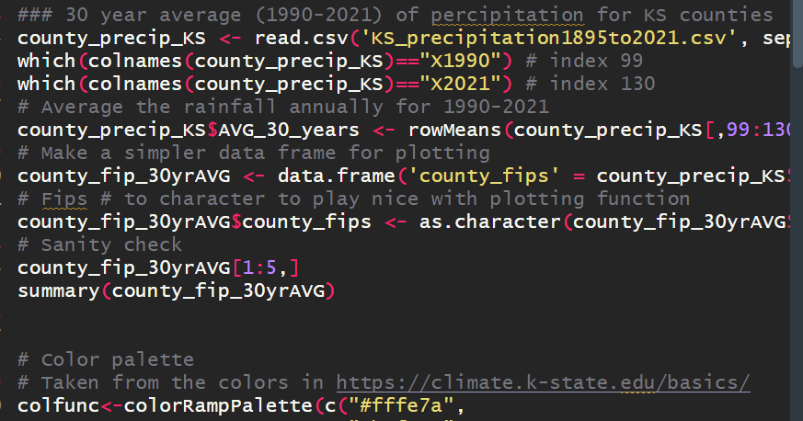
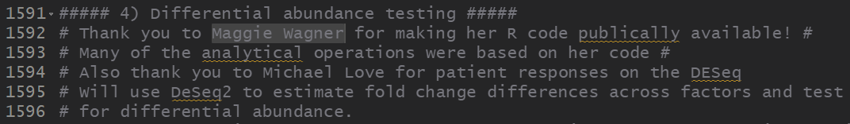
Why use github?
Collaborative coding is greatly simplified in a git/github environment.
To share the code required to ensure your analysis is reproducible.
Its often a journal requirement prior to publication.
To better the environment for others that come after you, sometimes the solution to ones problems have been solved before…
Fitzpatrick, Connor R., et al. "Assembly and ecological function of the root microbiome across angiosperm plant species." PNAS115.6 (2018)

Slide 8
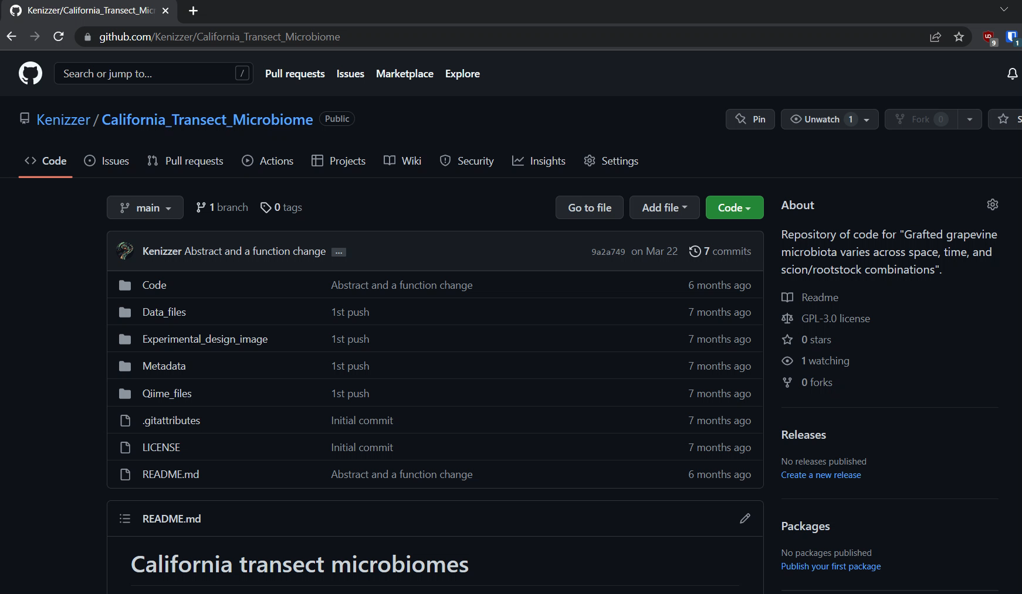
Repositories/Repos on github
https://github.com/Kenizzer/California_Transect_Microbiome

Slide 9
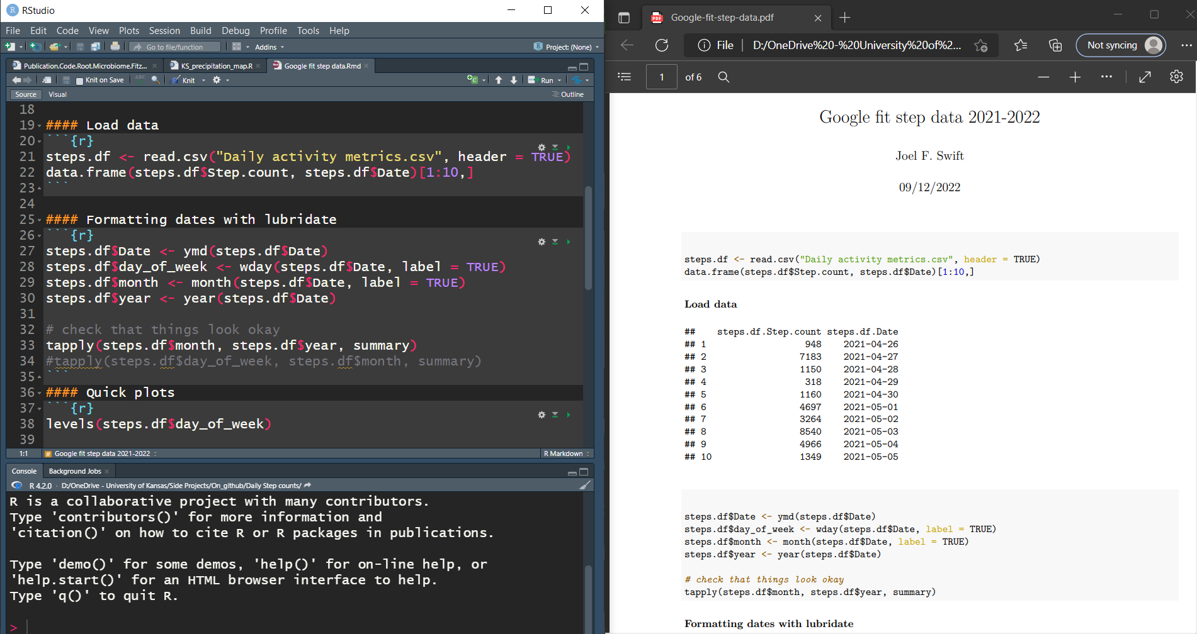
Repositories/Repos on github
The basics are:
A readme file that will be kind of like the home page of the repo.
Something you are wanting to share (i.e., code/analyses)
Readme files:
These are typically written in
markdown (not covered today)

Slide 10
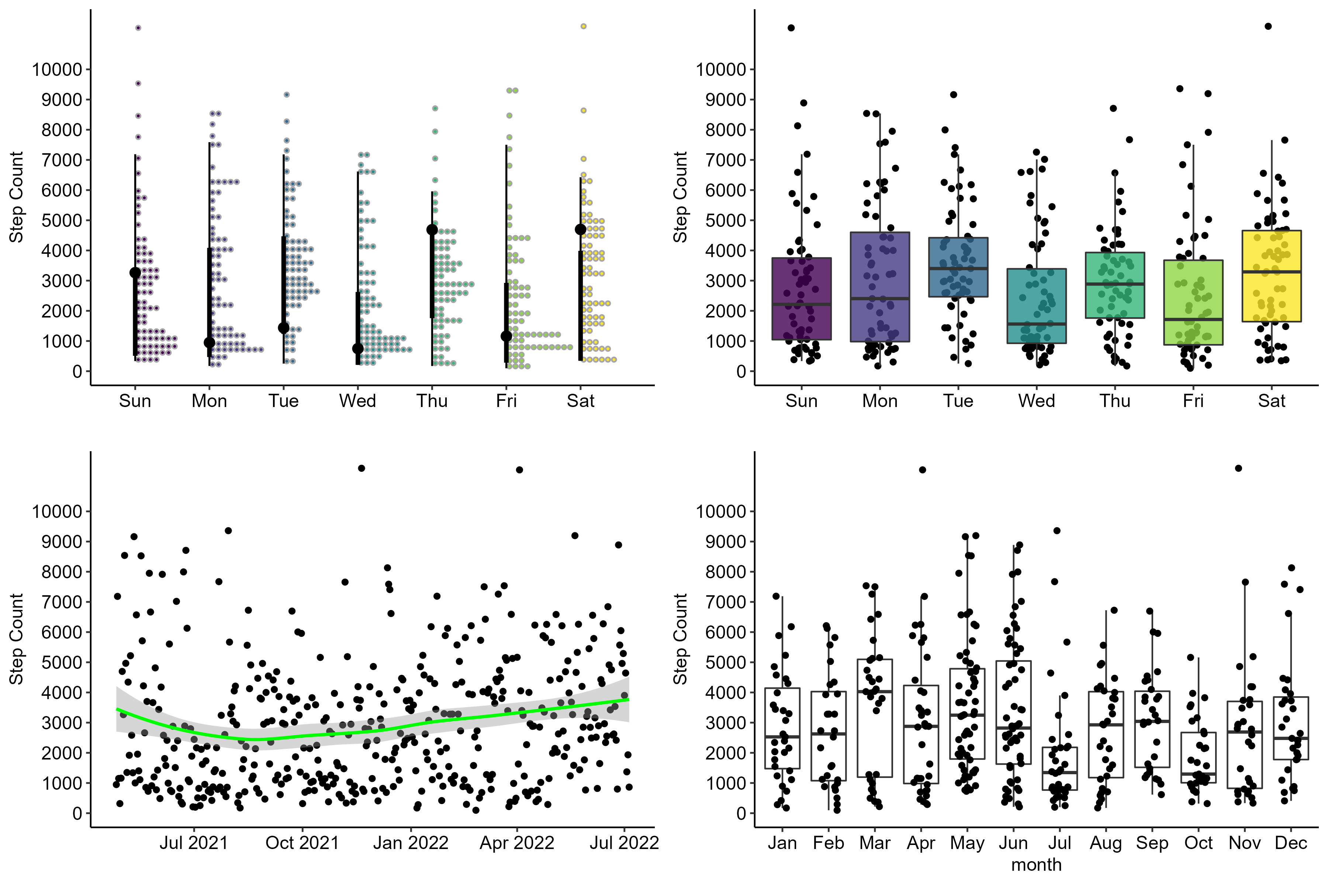
Example repo – Google fit step count data
I wanted to look for trends in the number of steps I took per day.
Data was collected by the phone application google fit.
~04-2021 to 07-2022.

Slide 11
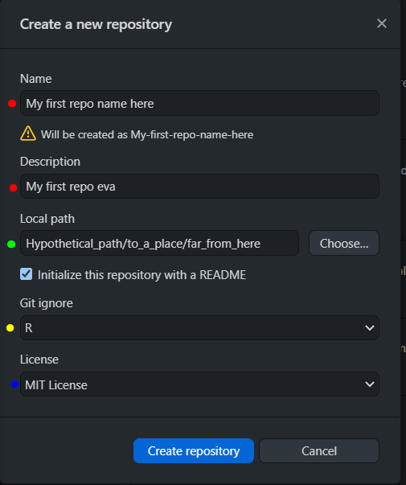
Adding a Repo
Name and description.
Local path to the repo (where the files are on your computer).
Git ignore template to use (in our case R will work).
License to use for the repo MIT and GNU are likely fine (particularly important for patentable research)

Slide 12
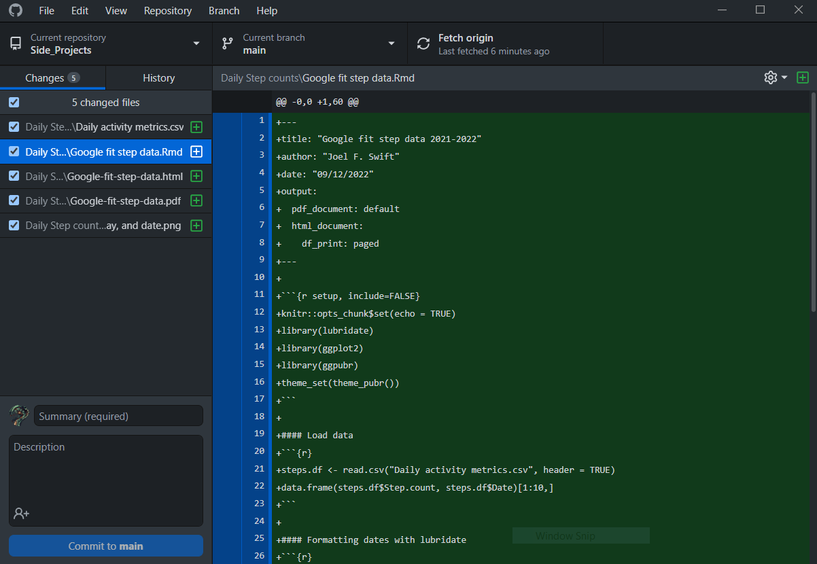
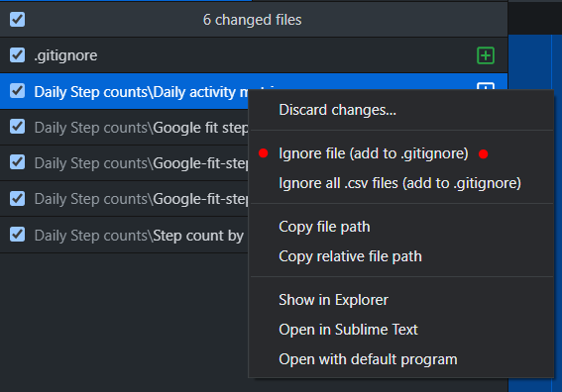
Committing changes to a Repo
Once you have a repo, adding any files into the repo folder will show up as a change in github desktop.
We can choose to ignore a file (aka don’t change or add to repo) if we like.
An example might be a dataset that contains GPS data you don’t want to share

Slide 13
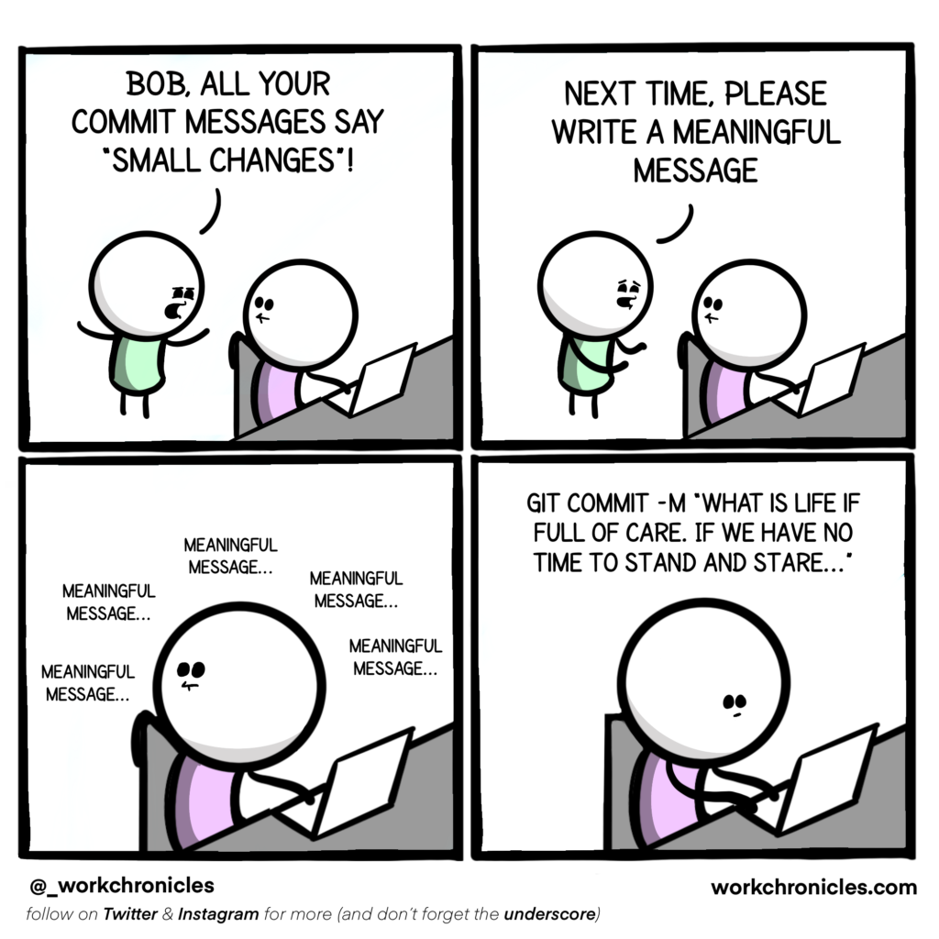
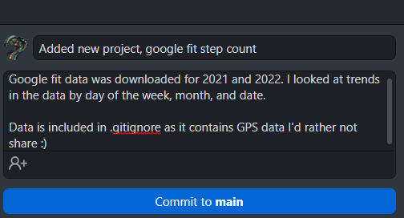
Committing changes to a Repo
Commit messages can be important to remember what changes were made.

Slide 14
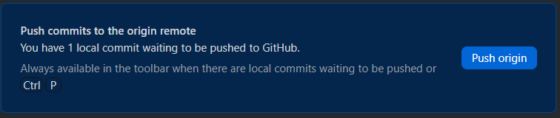
Committing changes to a Repo
Commit the change.
Choose the branch.
Push the change to the branch.

Slide 15
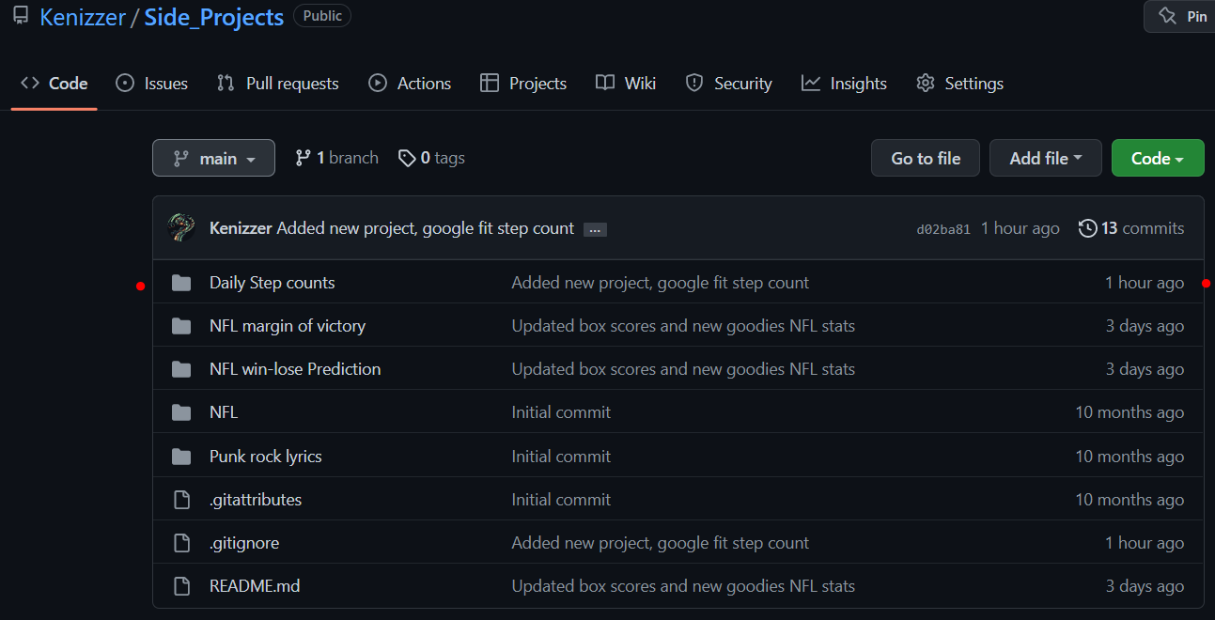
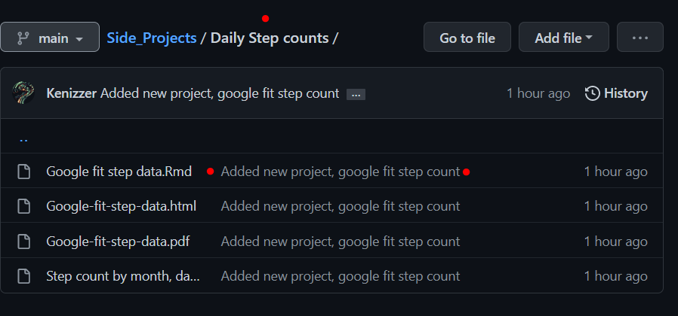
Lets look at the repo that was changed
https://github.com/Kenizzer/Side_Projects

Slide 16
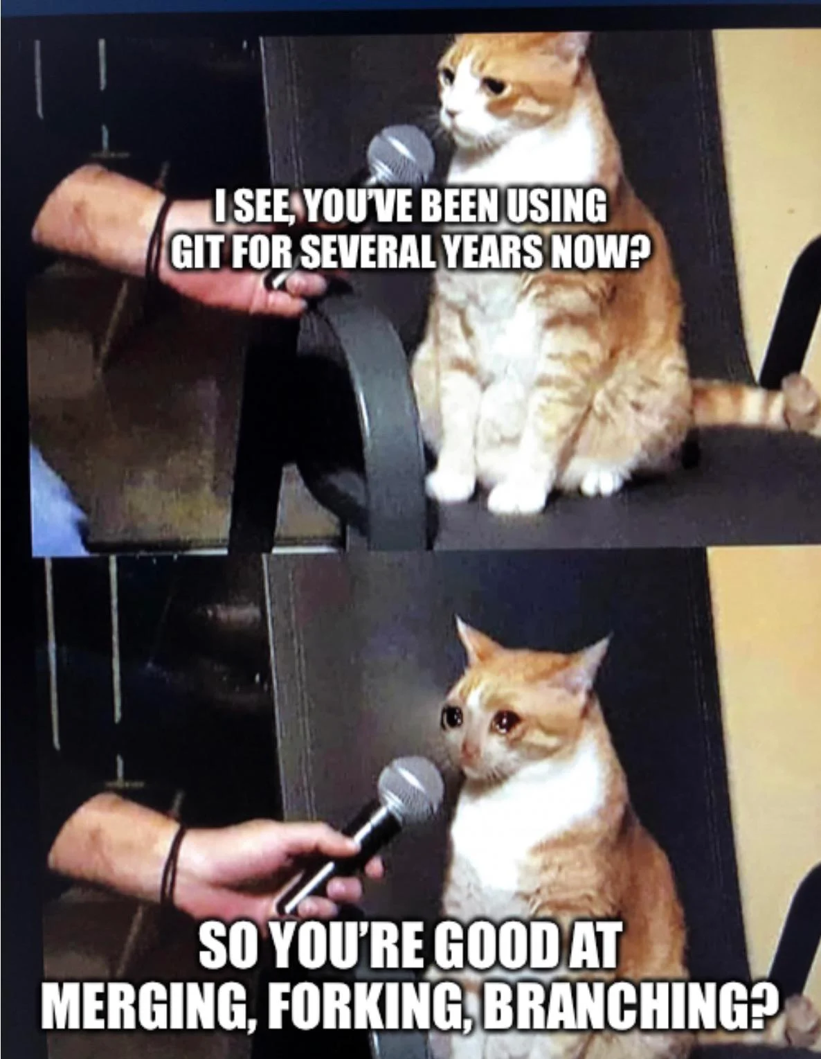
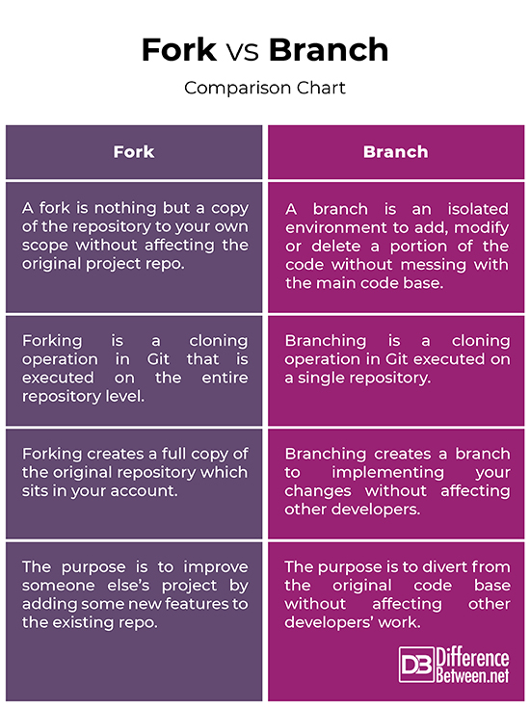
Working with others Branching and Forking
Fork repos that you are not a collaborator on.
Create a new branch when you are actively working with the or are the main coder

Slide 17
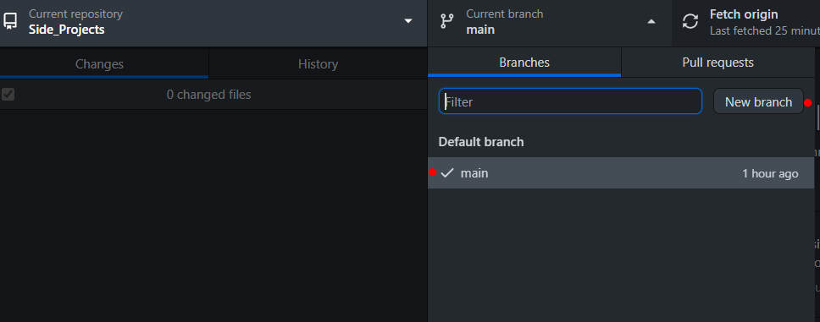
Branches
Typically there will be a single main branch (often named main or master¹) for a repo.
When you would like to work in a new environment, you make a new branch.
Why? Often its to try to fix or add things that have the potential to break other parts of the code. This way an important software can have a stable (main) branch and a dev branch for experimenting.
¹ https://www.theserverside.com/feature/Why-GitHub-renamed-its-master-branch-to-main

Slide 18
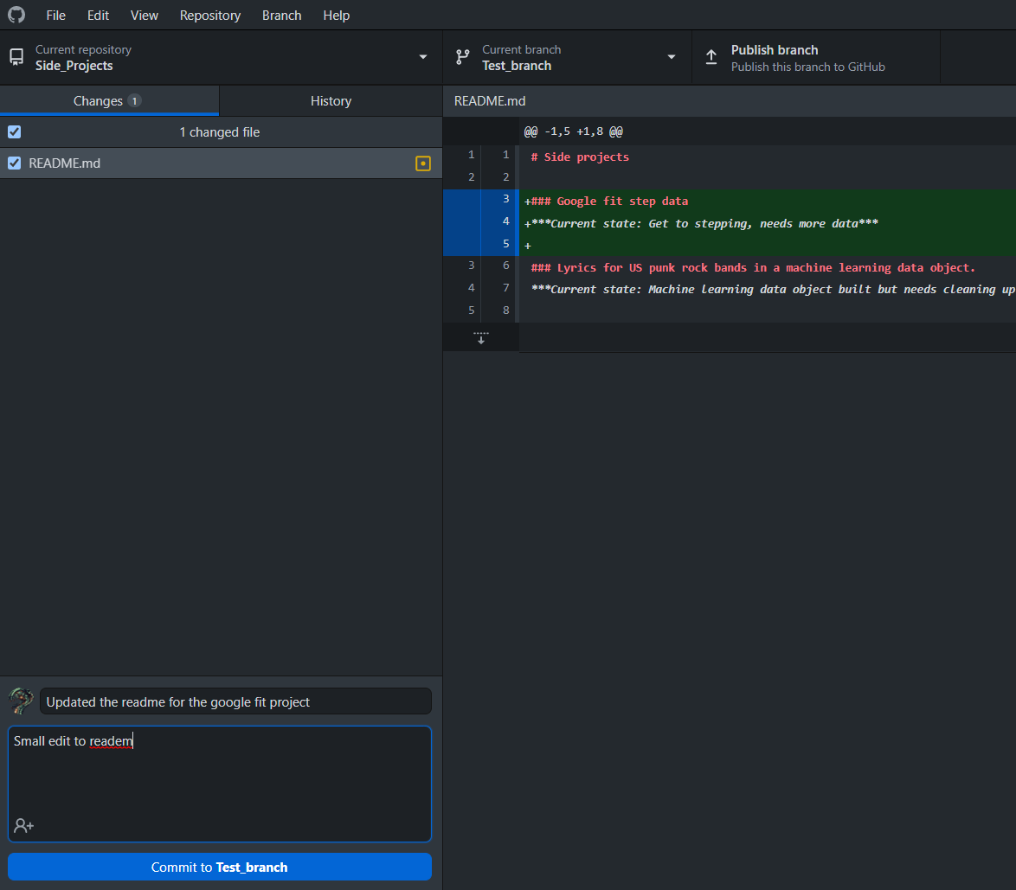
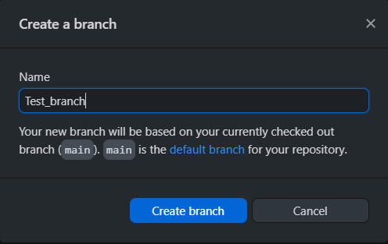
Branches
Change committed!

Slide 19

The dreaded Merge Conflict
What happens when we attempt to merge branches that have changes to the same file? Which version do we choose?
Merge Conflicts!!

Slide 20
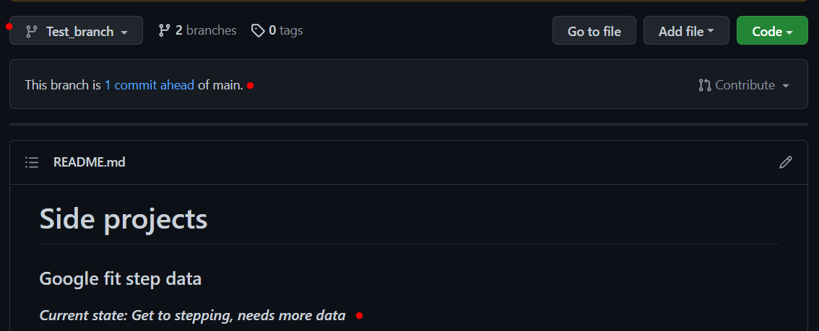
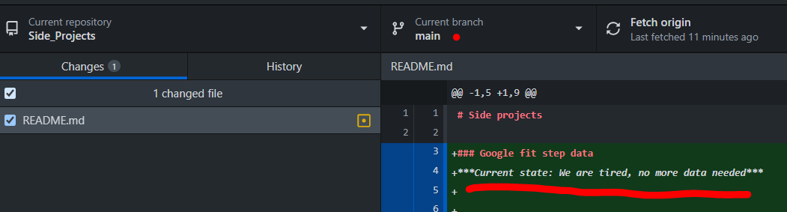
Test ->
Main ->

Slide 21
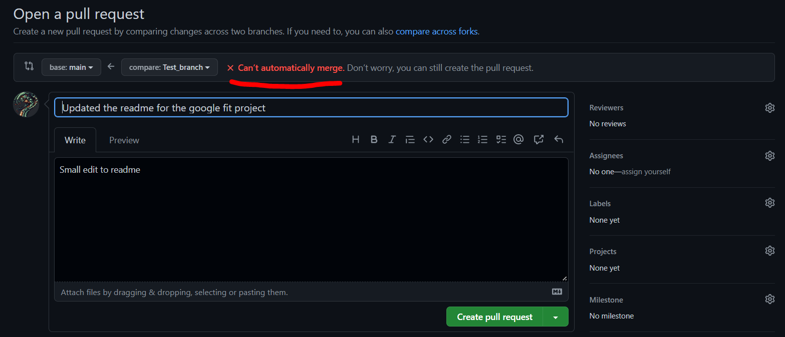
Pull request

Slide 22
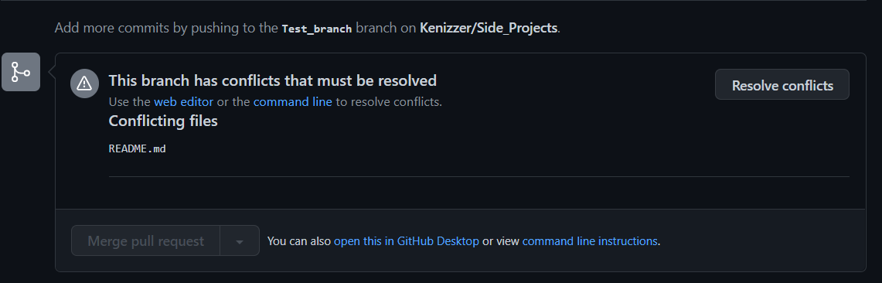

Slide 23
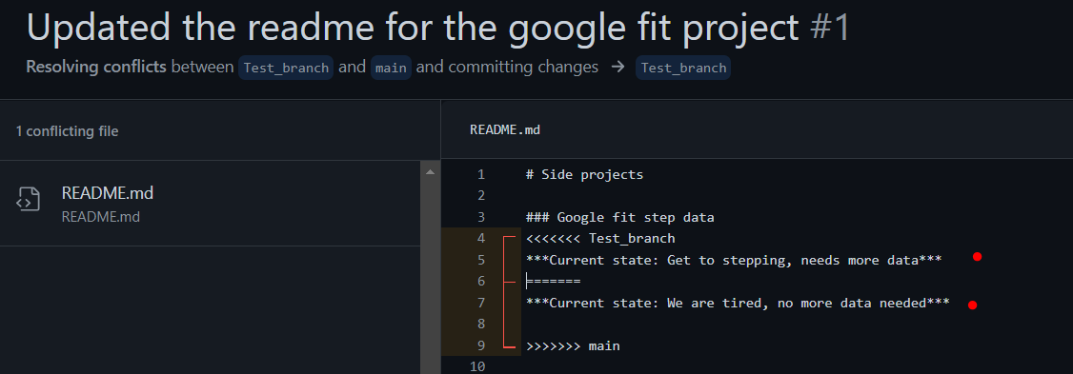
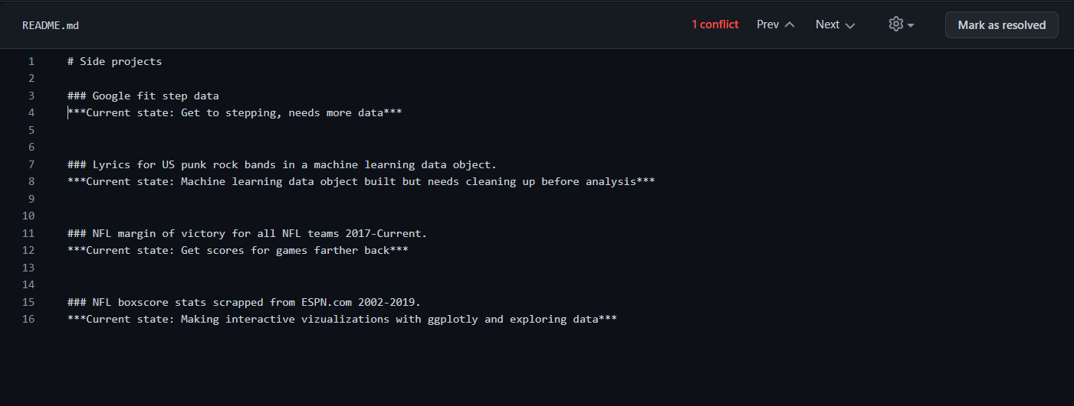
Resolved by deleting one of the lines about the google fit project.

Slide 24
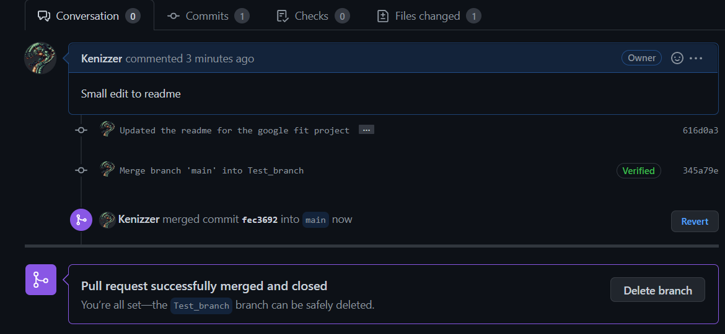
Commit has been merged after resolving the conflict

Slide 25
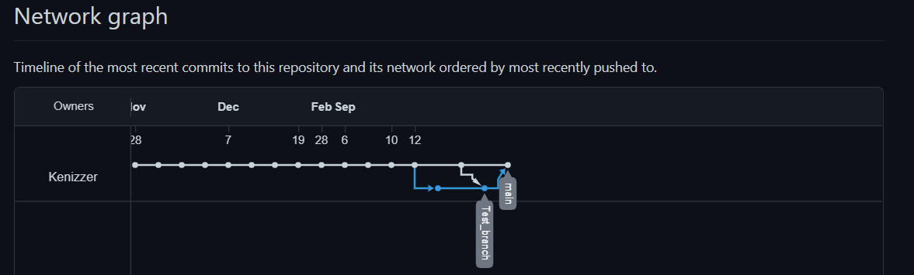
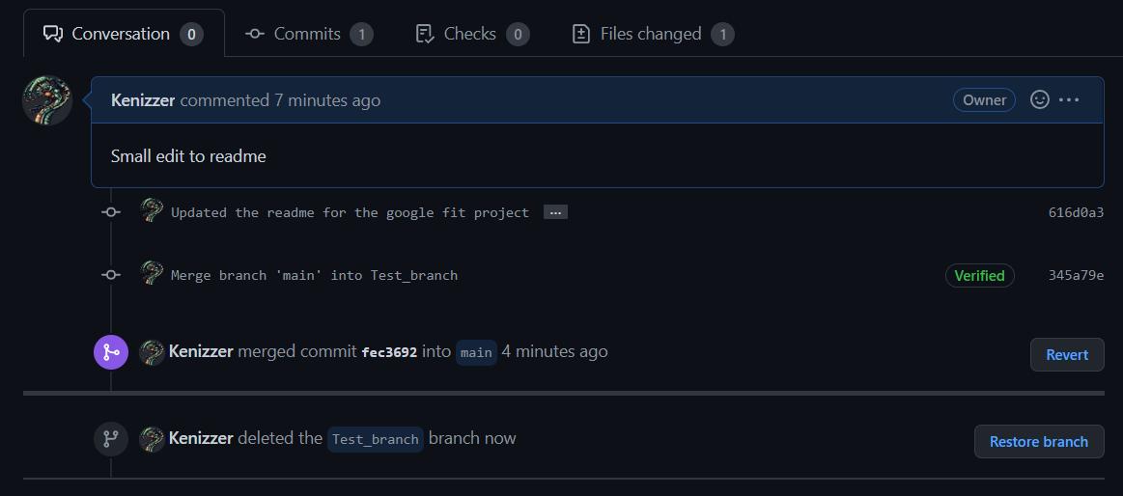

Slide 26
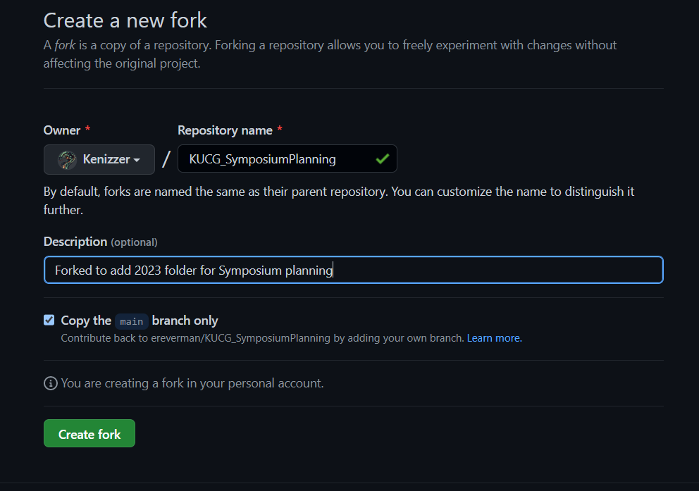
Forks
Create forks when you would like to contribute to a project you did not create.
Example: The 2022 KU symposium had an repo on github, I wanted to make the 2023 repo.

Slide 27
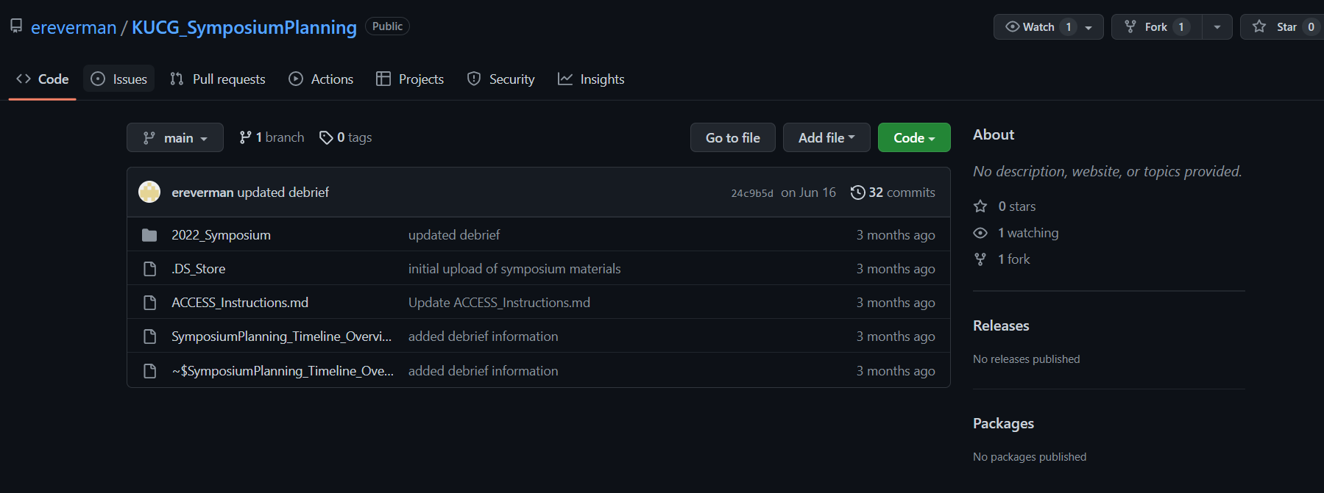
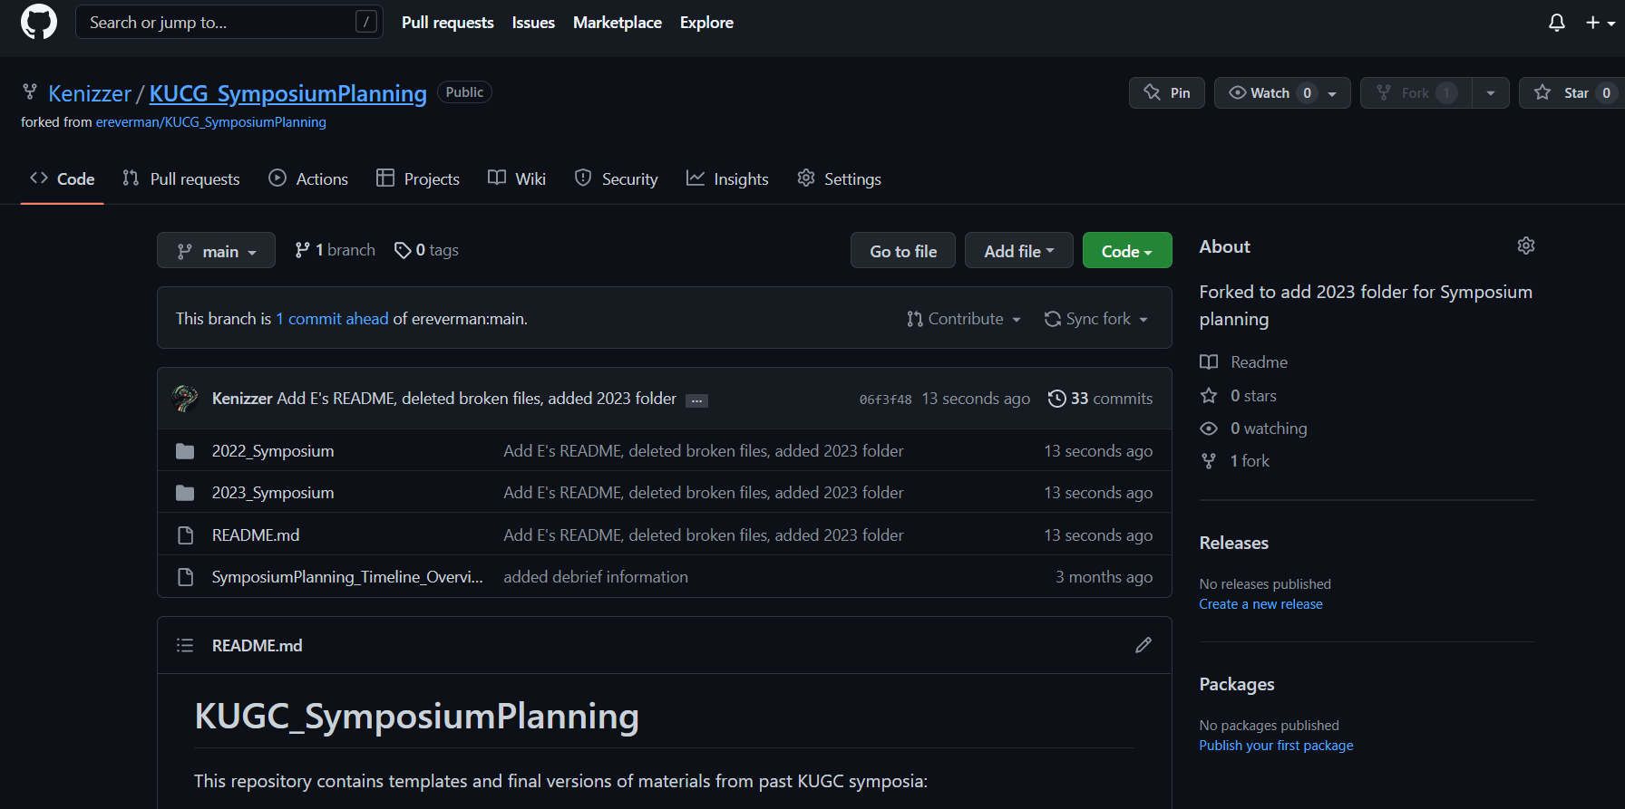
Forks
Now we clone the directory locally.
Then we make our changes and contributions and commit and push them.

Slide 28
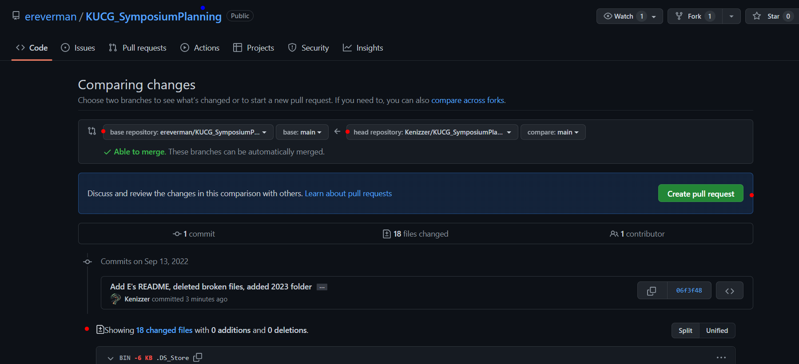
Open a pull request

Slide 29
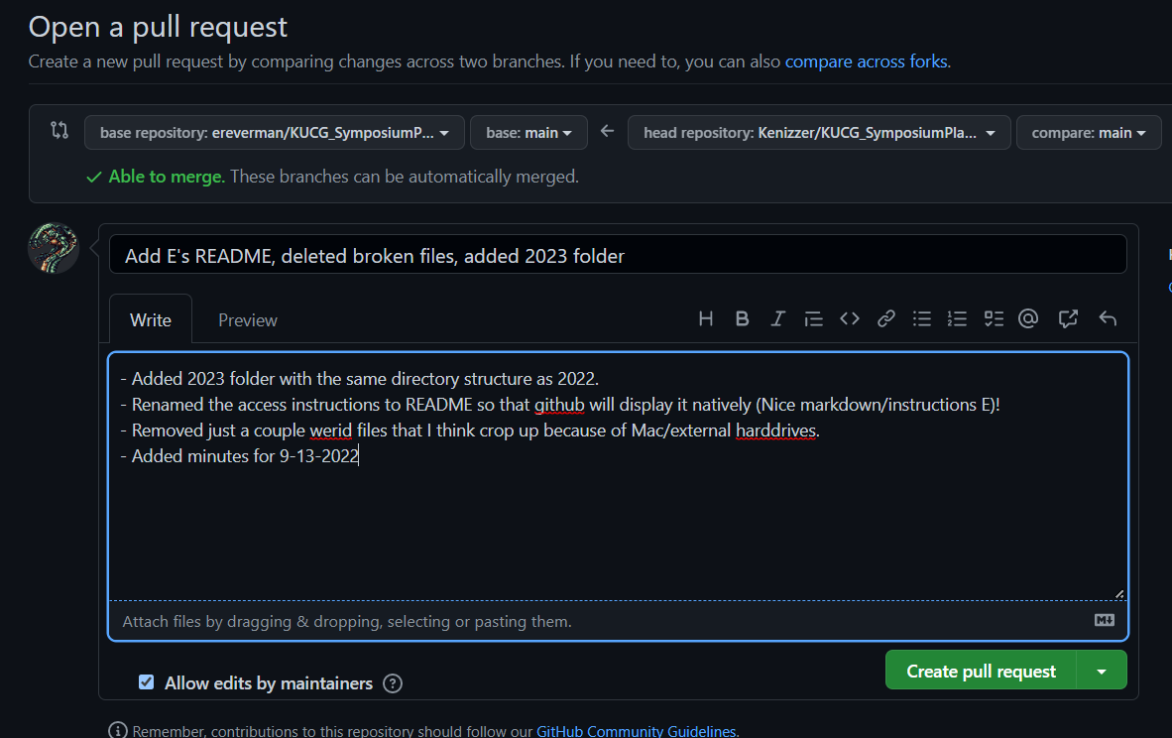
Open a pull request
Notice the message that we can auto merge?
Why is that?

Slide 30
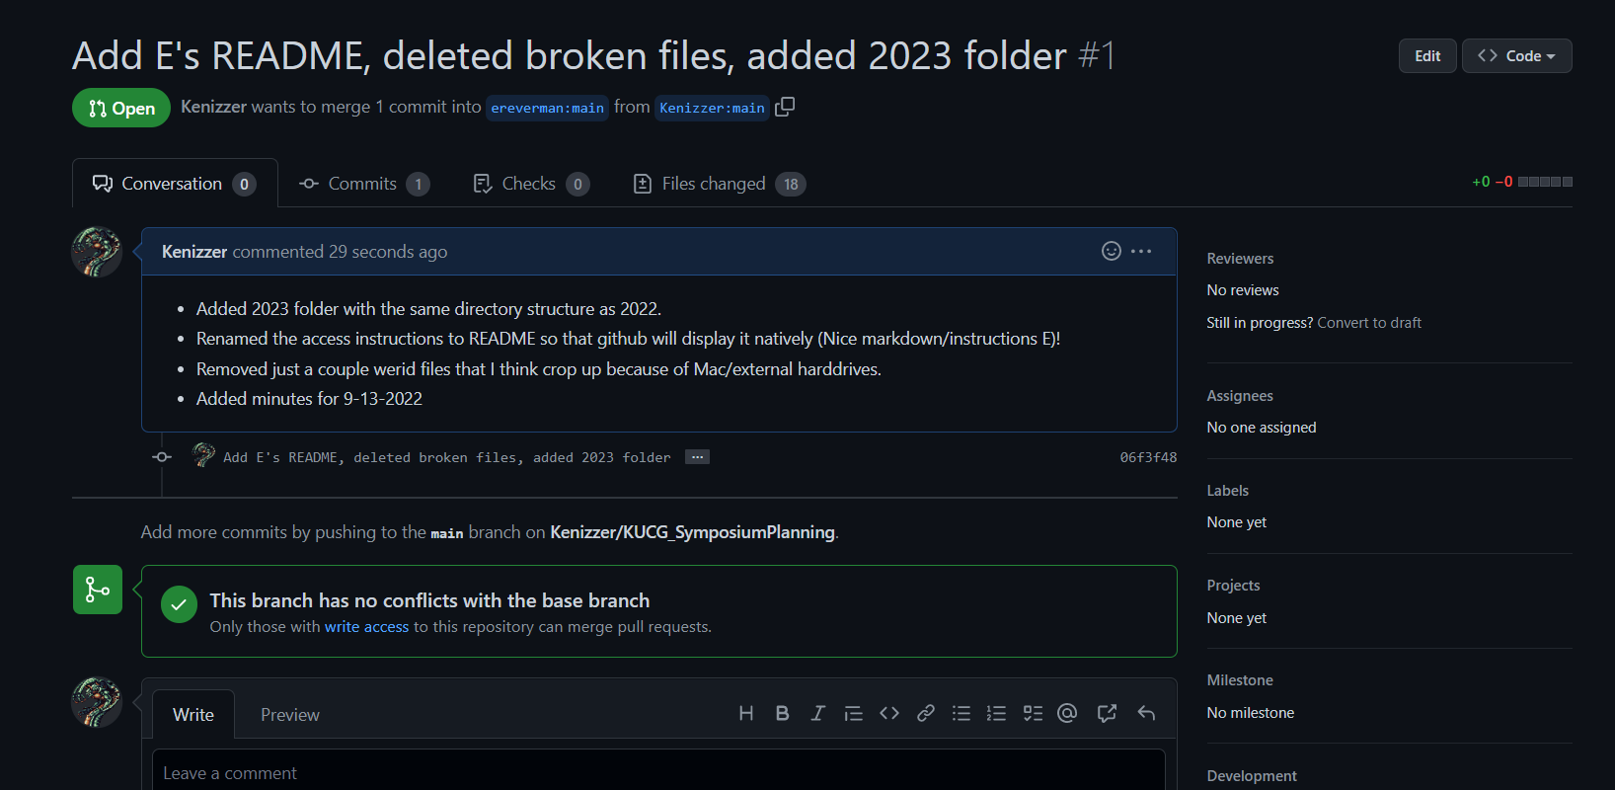

Slide 31
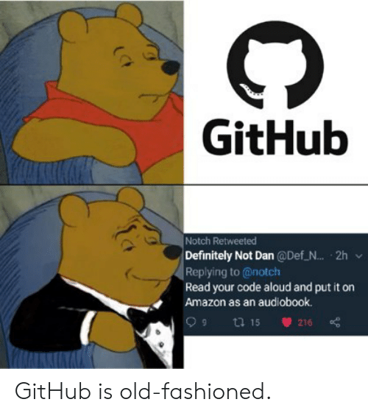
Questions?

